Slide 1

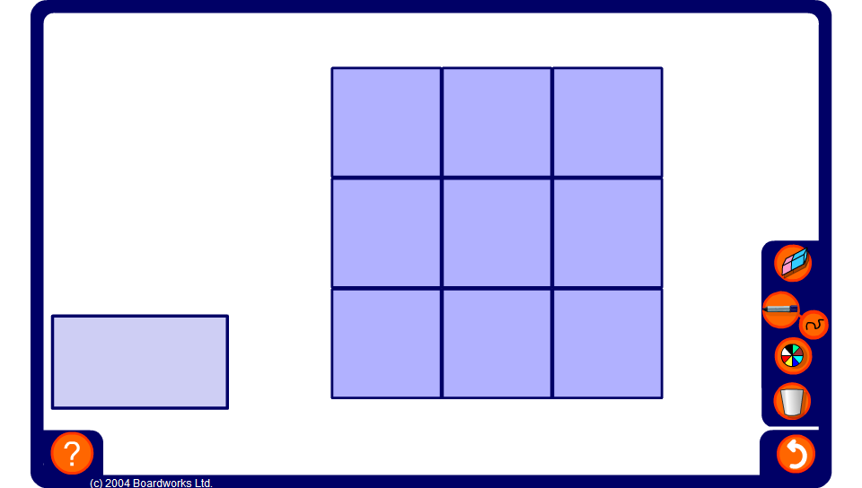


Fractional magic square
Notes:
Explain to pupils that in a magic square each row, column and diagonal adds up to the same amount. This amount is called the magic total.
Start by working out the magic total and then ask pupils for any squares they can work out.

